Slide 1
EYFS - Reception
Welcome Meeting 2026

Slide 2
Meet the Team
Head Teacher / Safeguarding Lead – Mrs Dring
Deputy Head / SEND Coordinator – Miss McMillan
Reception Teacher – Miss Taylor
Reception Teaching Assistant – Mrs Fielding (NNEB)

Slide 3
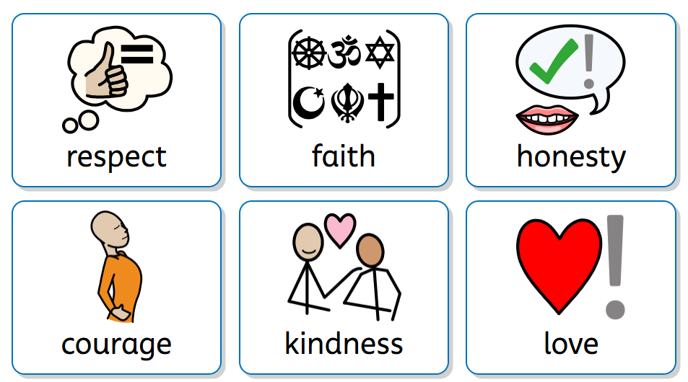
Our Ethos
‘Immersed in a Christian community, each individual is encouraged, challenged and nurtured to learn and grow to achieve their full potential’.

Slide 4
Something we want you to know…
Starting school is a special milestone for both children and their families. In our caring Christian community, we ensure that every child feels safe, valued, and supported from their very first day. We nurture the whole child—academically, socially, and emotionally—helping them to grow in confidence, develop a love of learning, and begin their journey towards a hopeful and fulfilling future.

Slide 5
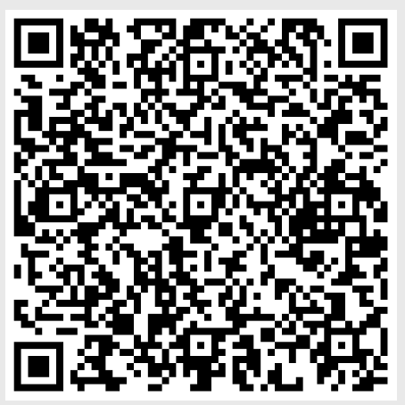
The EYFS Curriculum
Scan for Development Matters document.
The EYFS Curriculum is made up of 7 areas of learning.
3 Prime Areas:
Communication and Language
Physical Development
Personal, Social, Emotional Development
4 Specific Areas:
Literacy
Maths
Understanding the World
Expressive Arts and Design

Slide 6
The Early Years Curriculum
The EYFS Curriculum is used to build a progressive learning program based on your child interests and needs.
The EYFS curriculum taught at St Michael’s focuses on developing the whole child and not just cognitive or academic ability.
Cognitive development must proceed hand in hand with their social and communication development.
Knowledge and professional judgements of a child’s ability are made using observations, taught sessions, focus tasks, high-quality interactions and exploratory play opportunities.

Slide 7
Communication is Key!
Communication is at the heart of everything we do. Every session that is taught will develop communication, language and listening skills.
At school we encourage children to express their ideas and opinions. We want children to be able to make comments and suggestions about things they have heard.
Our environment, inside and outside will be vocabulary rich to support reading, communication and language in all areas of learning.

Slide 8
Uniform
We encourage children to wear the uniform with pride. Therefore, children should wear the following:
Girls: tartan skirt or navy trousers, navy cardigan or jumper (with school logo), gold polo shirt. Yellow school summer dresses can be worn during the summer months.
Boys: grey trousers, navy jumper (with school logo), gold polo shirt.

Slide 9
PE Kits
Our school PE kit comprises of navy shorts, navy t-shirt (with school logo) and black pumps.
There is a school tracksuit available to purchase for outdoor PE sessions.
St Michael’s PE kits can be purchased from various shops around the Leigh and Atherton area, please speak to the school office for these suppliers.
Children are not allowed to wear dance wear – especially with bare midriffs.
Children should come to school in their PE Kit on the day they have PE. Children will have two PE days per week.
Notes:
Recent changes to PE kit
One indoor and one outdoor session

Slide 10

Early Reading and Phonics
At St Michael’s we follow the Soundswrite Programme to teach phonics.
Children in Reception will begin our Soundswrite programme from their very first day at school.
All children will start on initial code Unit 1 following the order of sounds in order to segment and blend simple CVC words before moving on to Extended code.
Soundswrite teaches pure sound without the added Shwar (The sound is ‘m’ not ‘muh’).
Children will be allocated a Phonics Reading book based on the Unit they are on.

Slide 11

Reading at Home
The best thing that you can do for your children in their early childhood is read, read, read!
Fostering a love for reading from an early age supports children’s language development and in turn supports their early reading.
At school, reading is of upmost importance to us. We share stories with the children every day and immerse our environment in high quality books.
Each week, children bring home a reading book tailored to their phonic ability and also a library book of their choice to read at home. These are changed weekly and you will be told your child’s day to change books at the start of the year.
It is a school expectation that children read every day at home for up to 20 minutes.

Slide 12
Early Writing and Motor Skills
At St Michael’s, we understand the importance of getting children ready to write. However, we ensure this is done at a child’s own pace.
In practice, this means lots of fine motor work with playdough, using small tools - tweezers, pipettes etc. and gross motor practice using chalk, paintbrushes, chunky pens, brushes, mops and more to prepare children’s muscles for the process of writing.
We have recently invested in a new handwriting scheme.

Slide 13
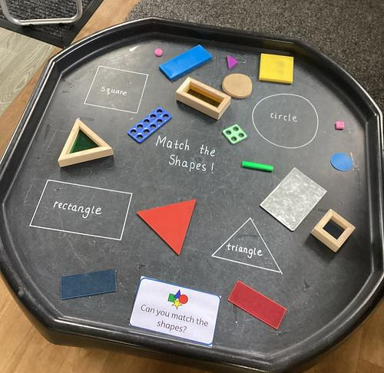
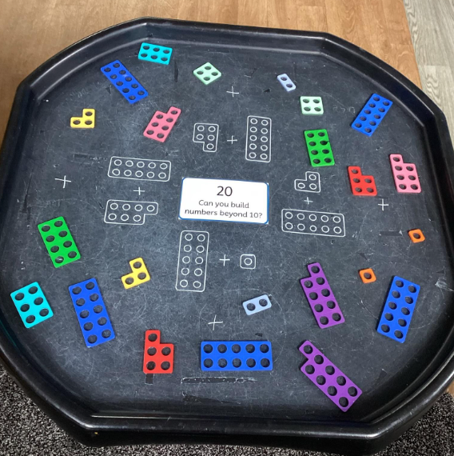

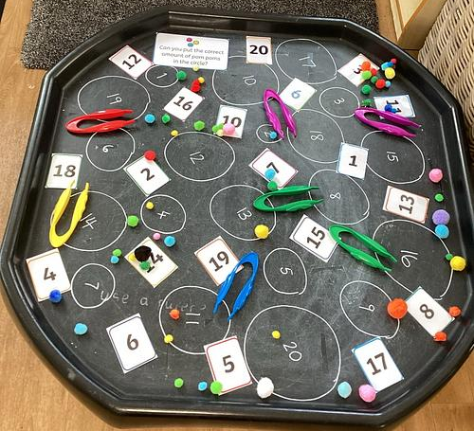
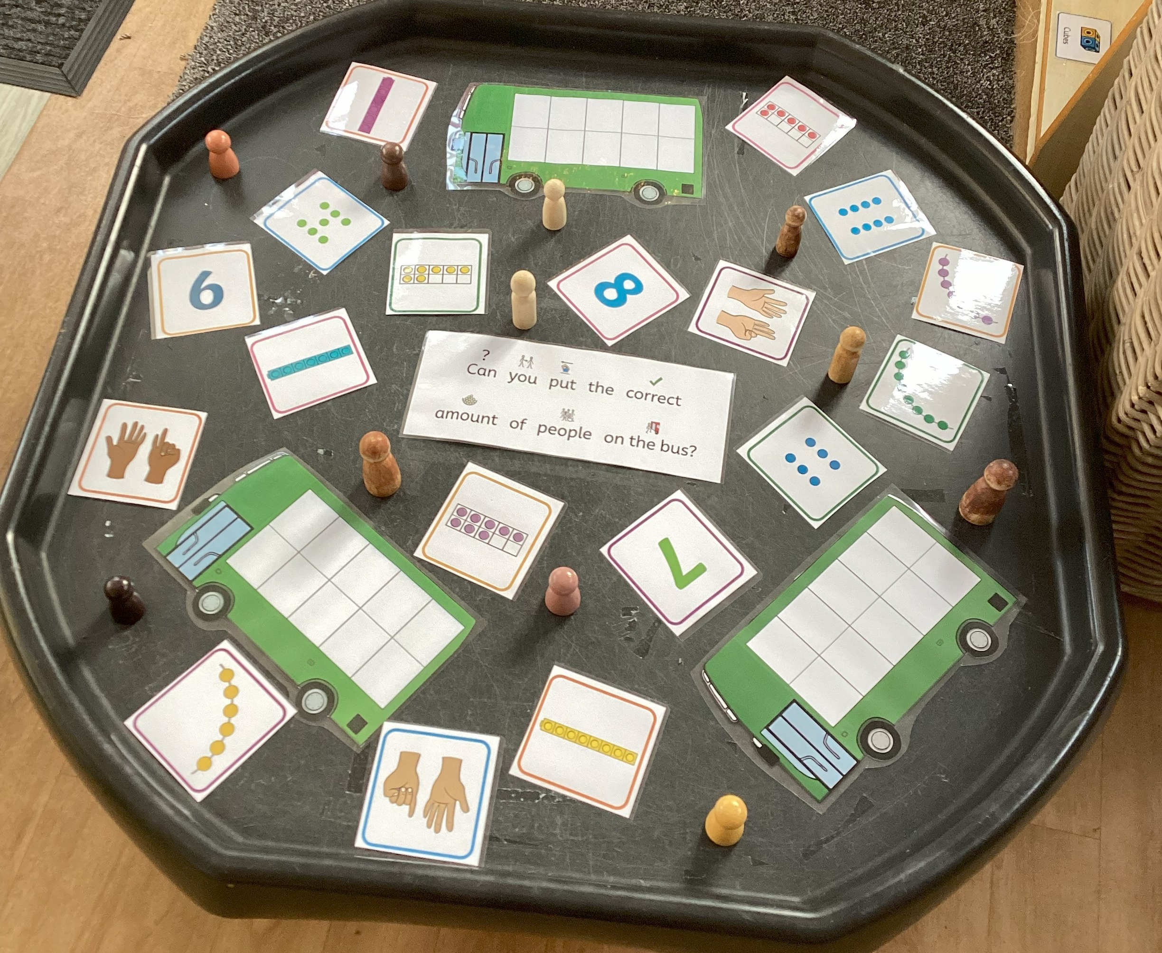
Maths
At St Michael’s we use White Rose Maths to structure the order of our maths sessions.
You can help at home by practising Number recognition and formation as often as possible.
The White Rose curriculum looks at gaining a broad understanding of number.
In Reception children will learn to read, write, order and manipulate numbers to 10 in a variety of ways before moving on to numbers up to 20.

Slide 14
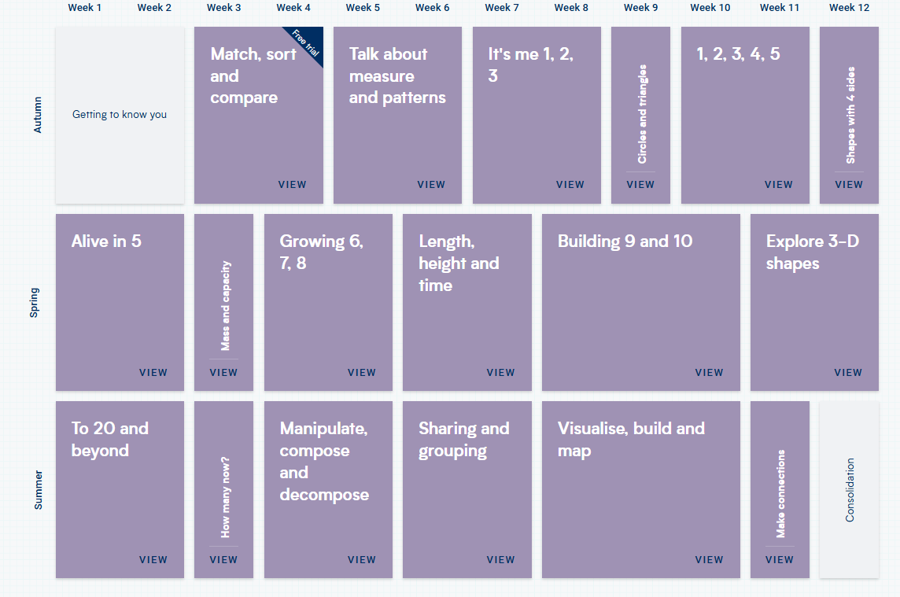

Slide 15
Continuous Provision
Children should be given opportunity to be creative through all areas of learning.
Children can access resources freely and are allowed to move them around the classroom to extend their learning.
Continuous Provision is setup in the classroom and outside to build upon their learning and enhance the experience they have.
Children are encouraged to explore freely and generate their own way of thinking/ learning.

Slide 16






Pathways to Write
"Pathways to Write" is a structured, mastery-based writing program designed to develop vocabulary, reading, and writing skills progressively from early years to Year 6.
Autumn 1 | Autumn 2 | Spring 1 | Spring 2 | Summer 1 | Summer 2
To depict the main events of the story using between 3 and 5 images. | To draw and label a plan to build a snowman including things that they will need to decorate the snowman at the end. | To create a new journey for the Naughty Bus by creating a story map and writing captions/sentences describing the journey of the bus | To retell/rewrite the story. | To rewrite the story. | To rewrite the story.

Slide 17
Our Curriculum Themes
Term | Curriculum Theme
Autumn 1 | Marvellous Me! Learning all about themselves, what makes them special, how we are all different and unique. Learning more about the children and their families/homes.
Autumn 2 | Fun Festivals Links to our P2W book. Learning about festivals all over the world.
Spring 1 | Out of this World! Learning about Space.
Spring 2 | Let’s Get Growing! Learning about the seasons. Learning about how plants grow.
Summer 1 | We’re Going on a Journey! Learning about maps. Discussing different journeys they have taken.
Summer 2 | Save our Planet Learning about our planet and how we can look after it.

Slide 18
Forest School
A Forest School is an outdoor, child-centred approach to learning that encourages children to explore, play, and develop skills through regular experiences in nature. Sessions are usually led by trained practitioners and focus on hands-on activities such as den building, tool use, nature discovery, storytelling, teamwork, and problem-solving.
The advantages of a forest school:
Builds confidence and self-esteem through achievable challenges and independent learning.
Supports mental health and wellbeing by reducing stress and encouraging mindfulness in nature.
Improves communication and teamwork through collaborative outdoor activities.
Encourages resilience and perseverance as children learn to manage risks and overcome difficulties.
Notes:
Hand over to SF

Slide 19
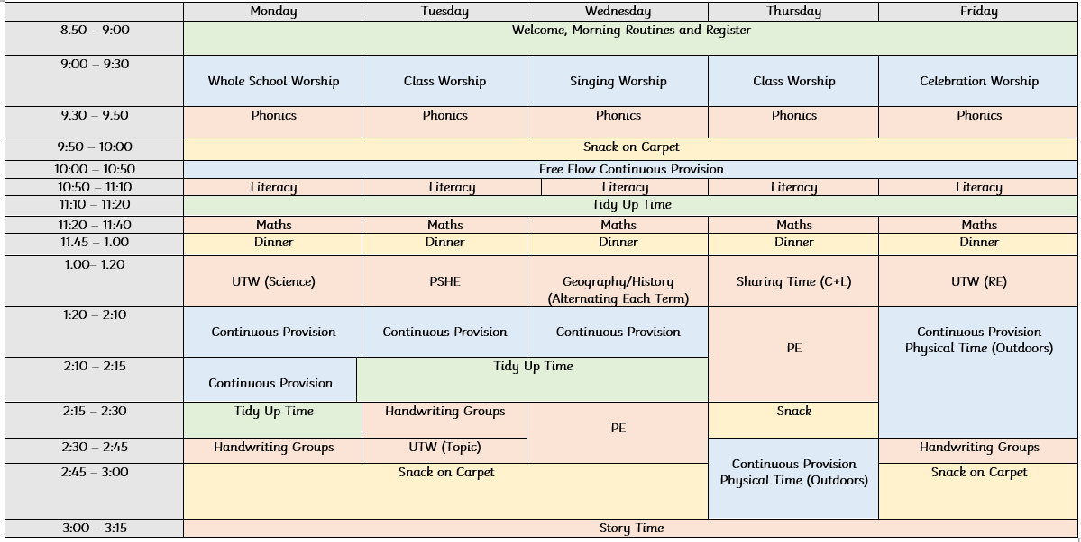
Our Timetable

Slide 20

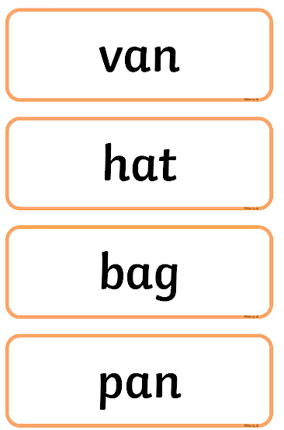
Homework
Blue Books – children will receive a blue book in which they will have sounds and words to practise. These will be updated weekly, dependent on the child’s progress.
Reading Books – children will receive a Sounds Write book to read weekly. When books have been read and an adult has written in the child’s reading diary, it will then be changed the following week.
Challenges – over the school holidays, children will be given challenges to complete.

Slide 21

House Teams
Your child will be allocated a ‘house team’.
Blue Kingfishers
Red Robins
Green Owls
Yellow Eagles
Your child’s house team will play a large part of their school journey. They are part of a team from the get-go!

Slide 22
Events
KS1 Colour Run
Autumn Walk
Festivals Arts and Crafts Competition
Polar Express Day
KS1 Christmas Pantomime
Nativity
Pancake Flipathon
Visits from PCSO Maria
World Book Day
Reception Mother’s Day Breakfast
Trip to Smithills Farm
Visit to St Michael’s Church
Picnic in the Park
Reception Tricky Word Challenge
Reception Class Graduation

Slide 23
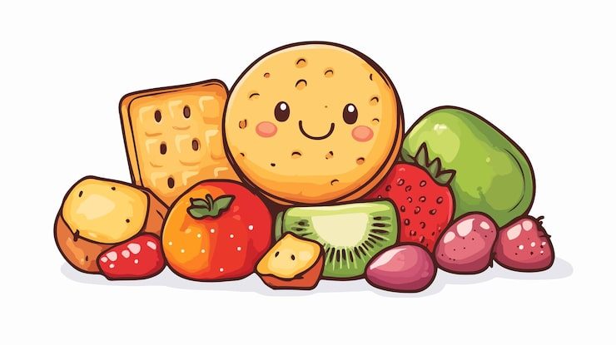
Snack Money
Snack money is £20 per half term. Your contribution helps provide:
A daily morning snack for your child.
A variety of healthy and balanced options.
Opportunities to try new foods and develop independence.
Snack money also helps fund exciting experiences that enhance our curriculum, such as:
Cooking and food-tasting activities. For example, when we learn about Space, we love to try some astronaut food!
Special themed days and celebrations. For example, Chinese New Year.
Hands-on learning experiences linked to class topics.
These opportunities enrich your child’s learning and make school even more enjoyable!

Slide 24
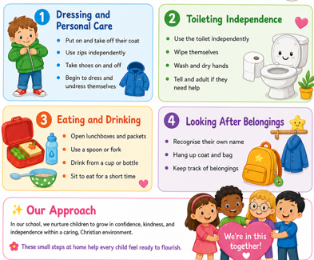
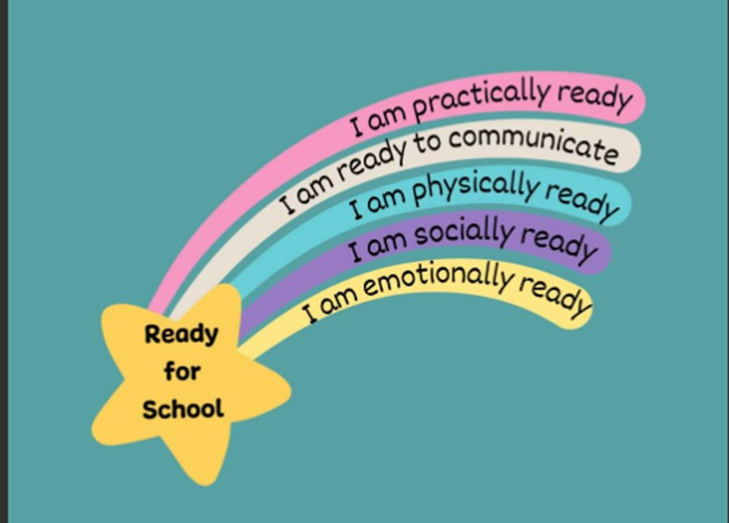
Getting Ready for Reception!

Slide 25

Your Child’s First Day
A home visit will be arranged with your child’s class teacher and teaching assistant. Home visits will take place on 2nd or 3rd of September.
Start dates will be staggered to allow children to settle in at their own pace. Your child will start on 7th or 8th of September.

Slide 26
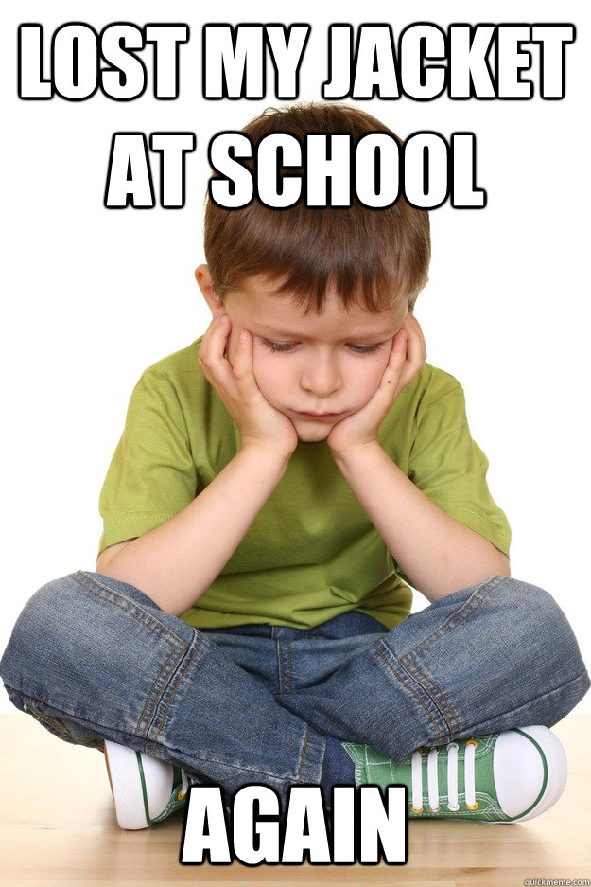
IMPORTANT NOTICES
Children are encouraged to be responsible for their own things when coming in to and leaving school however staff will of course always help. We do ask that children refrain from bringing toys or other personal belongings into school that could get lost or broken.

Slide 27
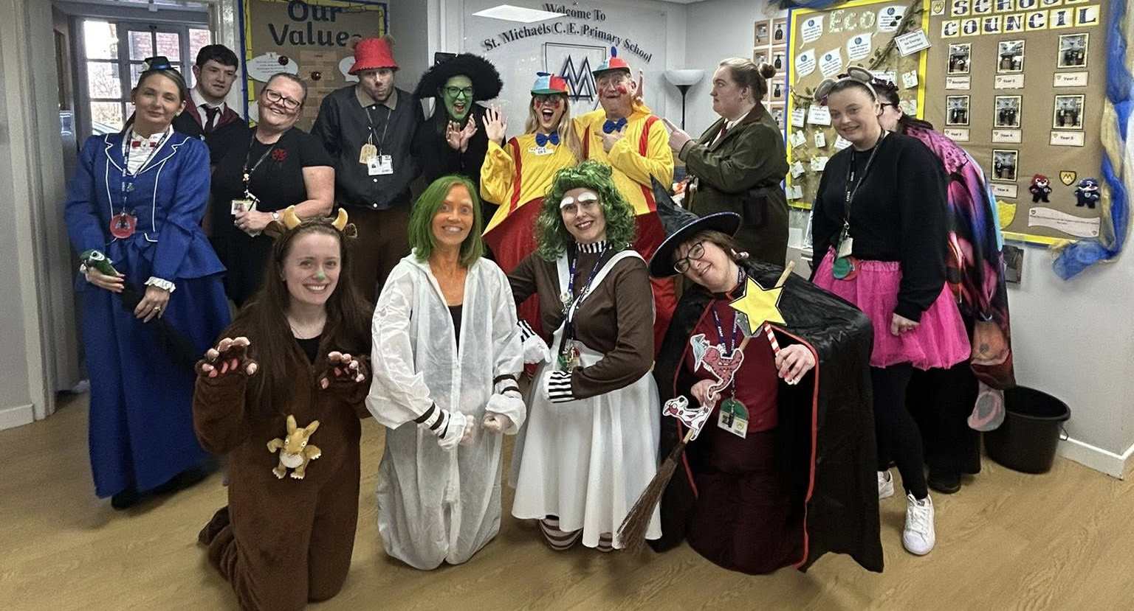
Thank you for coming☺
We are so excited to welcome your child into the St Michael’s family.

