Slide 1
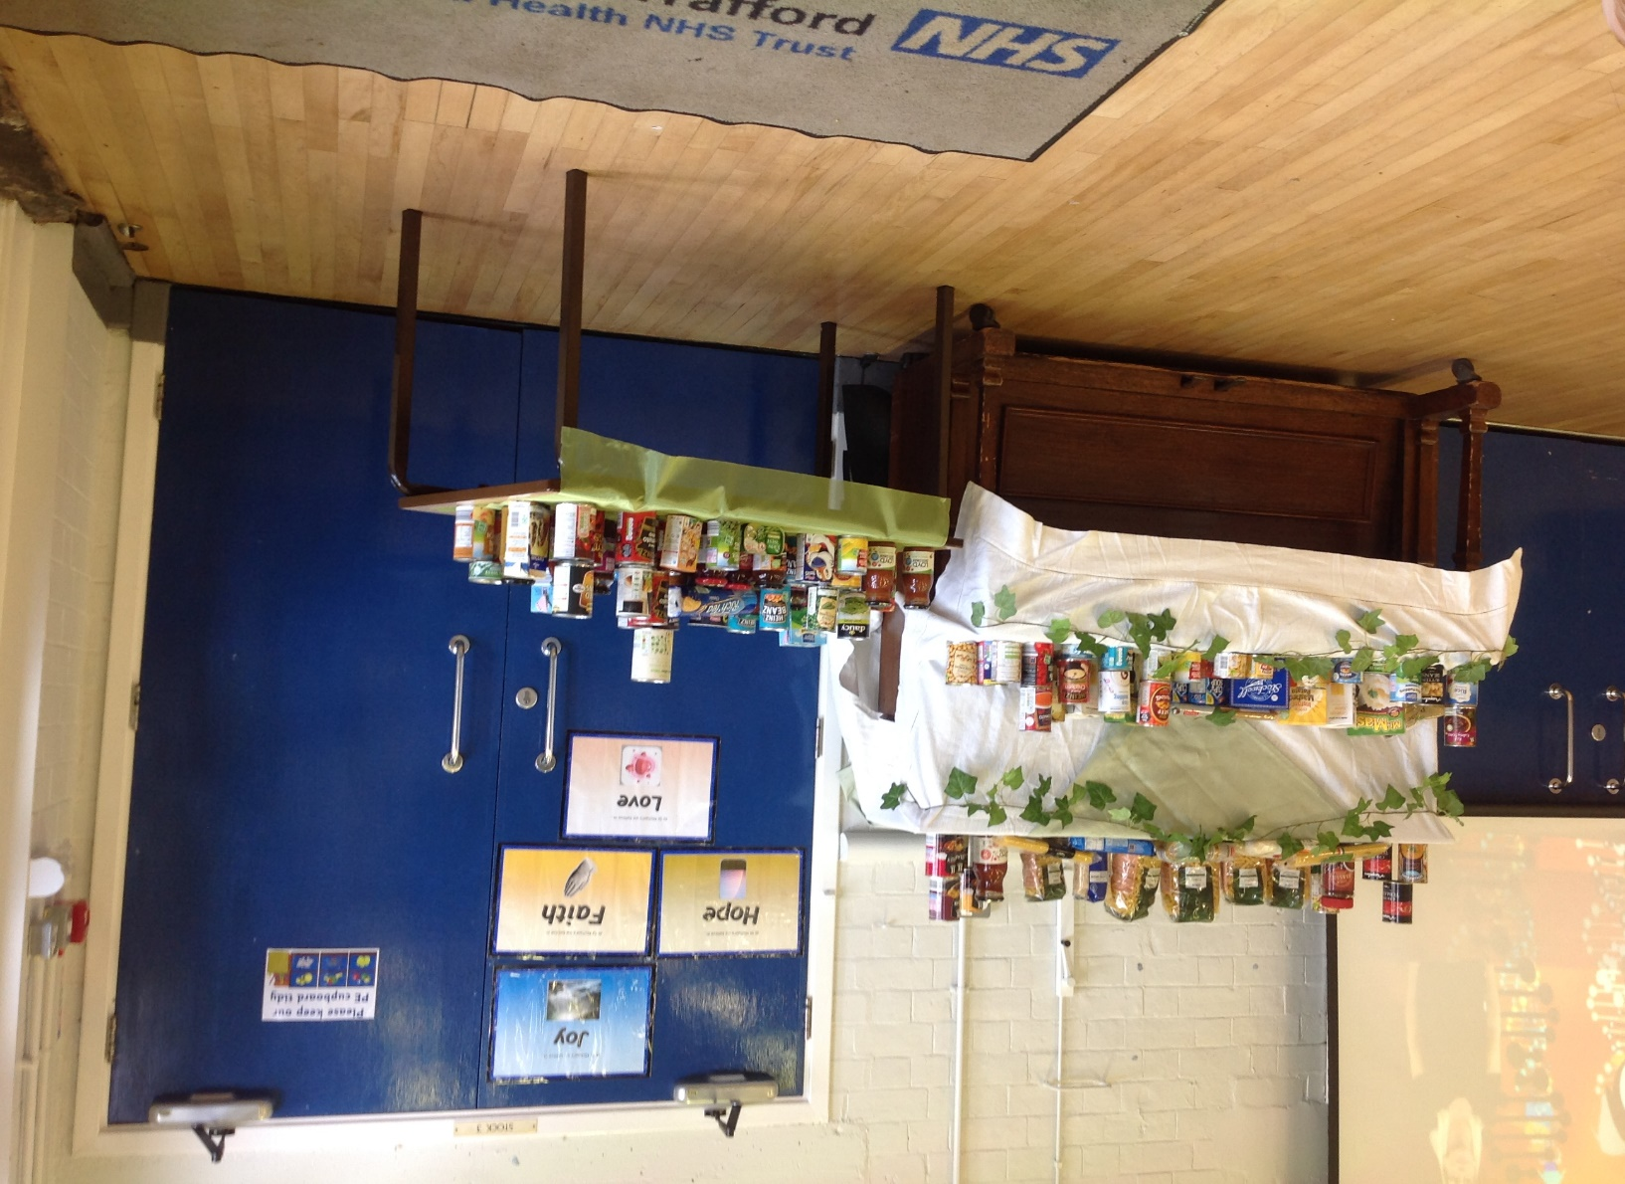
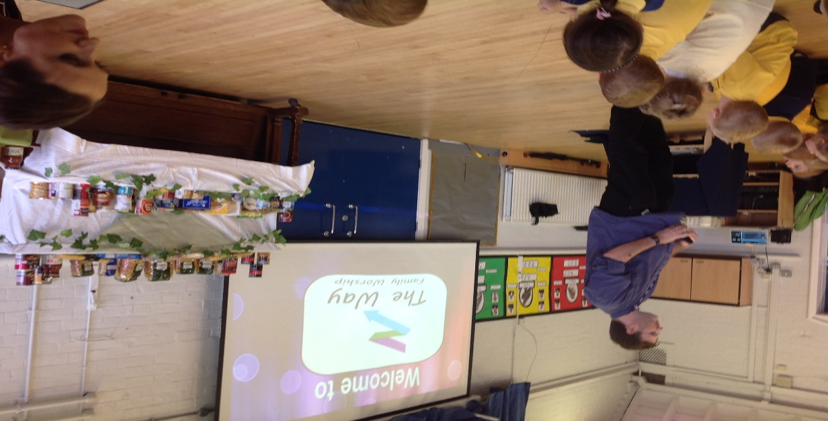
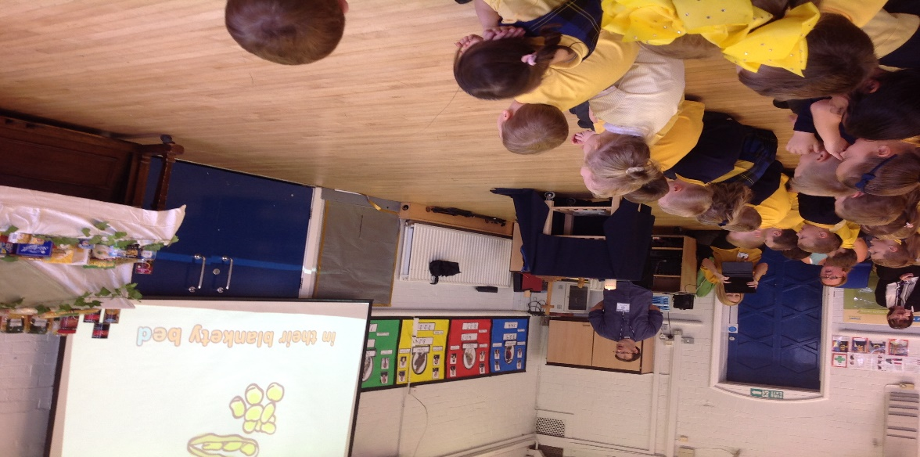
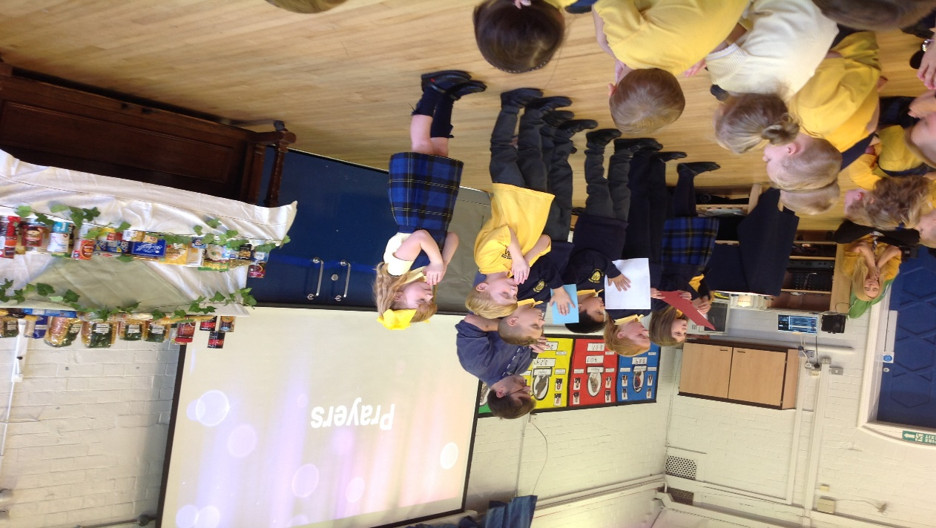
21.9.18
We enjoyed taking part in the Harvest festival service that Reverend Moores led.
We donated food to the Atherton and Leigh foodbank.

