Slide 1
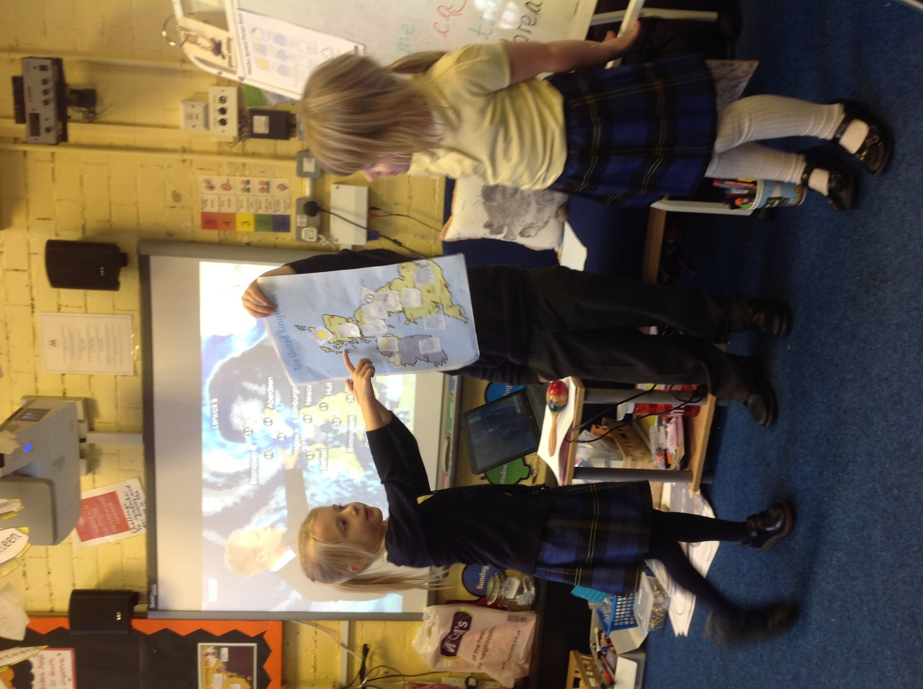
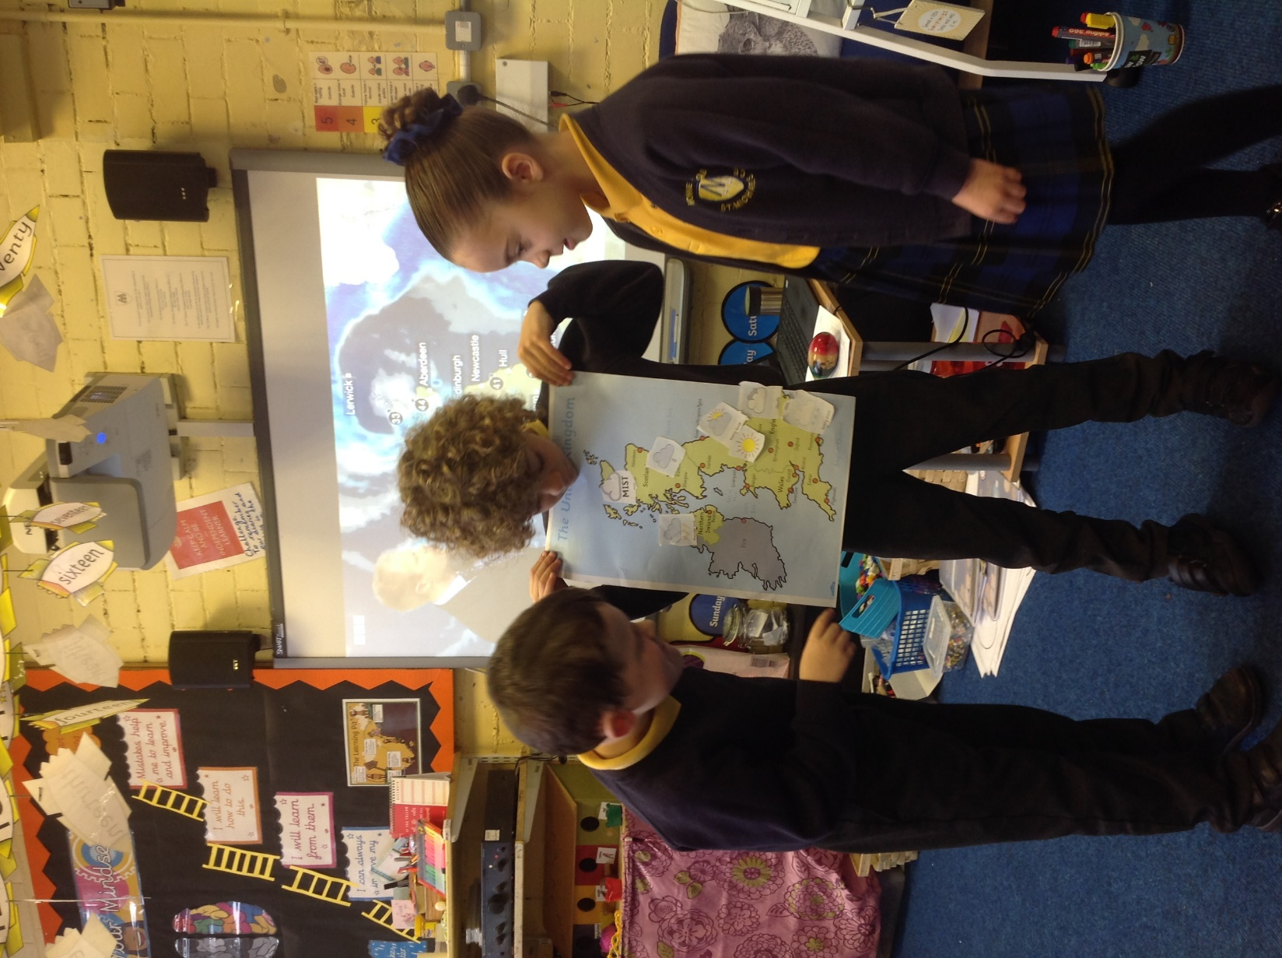
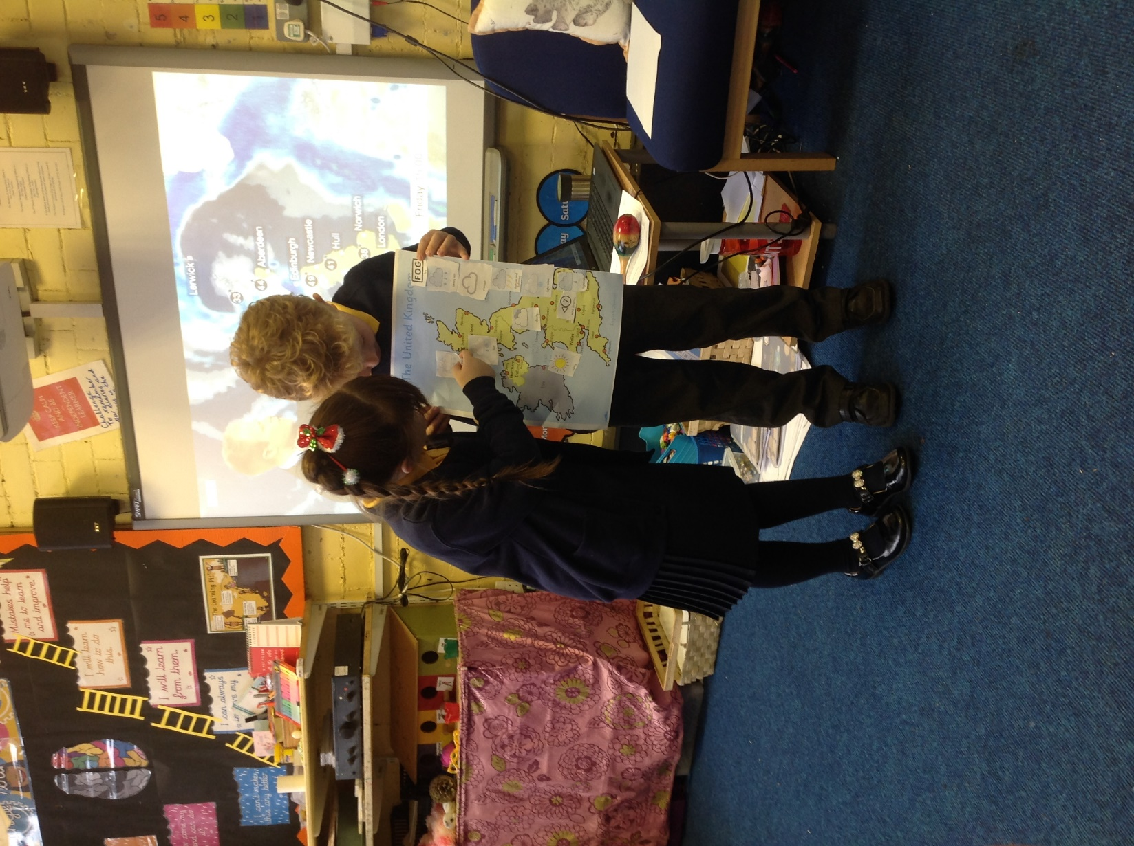
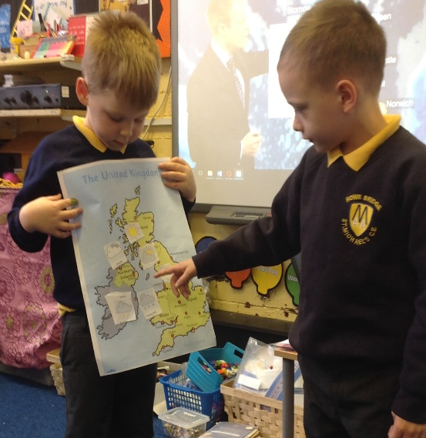
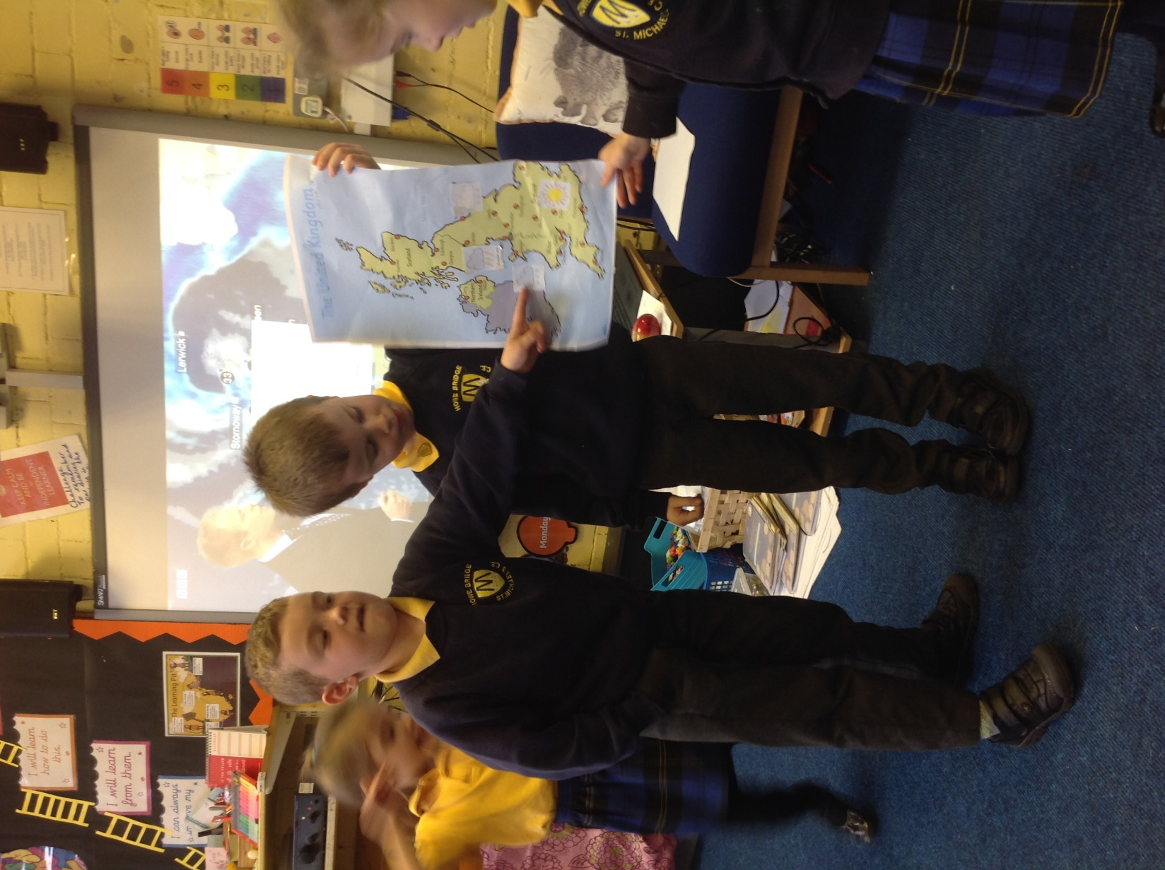
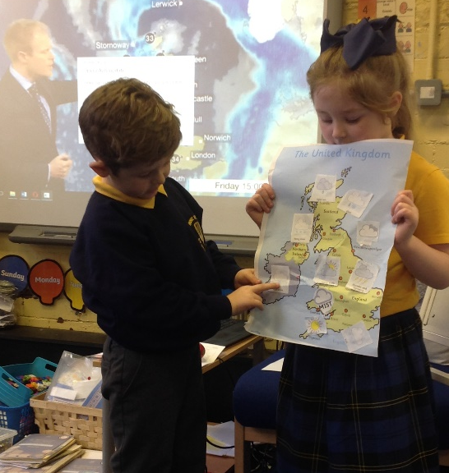
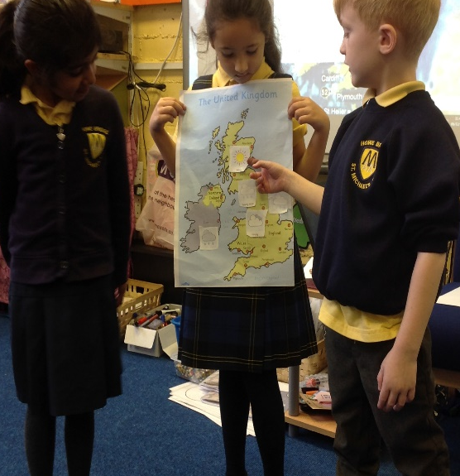
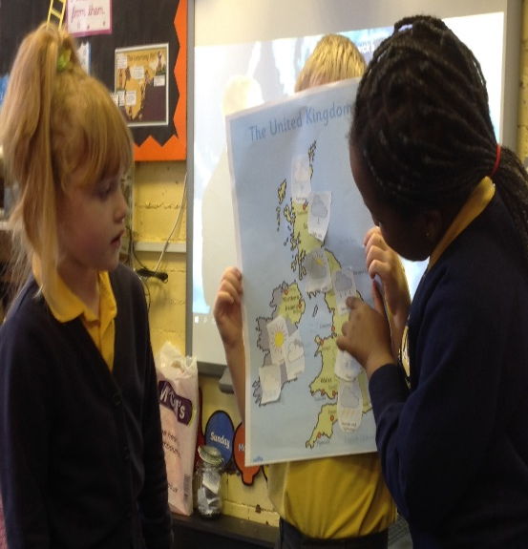
30.11.18/6.12.18 (ST)
The children explored the weather and become weather forecasters. They worked in groups and presented the weather for Autumn. They divided the weather forecast into the UK regions.
They also created a rain gauge and anemometer to measure the weather scientifically as an ongoing observation.

Slide 2
30.11.18/6.12.18 (ST)
The children explored the weather and become weather forecasters. They worked in groups and presented the weather for Autumn. They divided the weather forecast into the UK regions.
They also created a rain gauge and anemometer to measure the weather scientifically as an ongoing observation.

