Slide 1
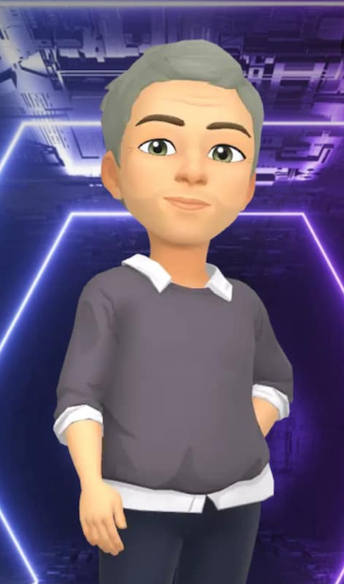


Welcome to
Year 6
Class Teacher –
Miss. Chadwick
Teaching Assistant –
Mr. Jones Stanley

Slide 2
Overview of the year
Timetable
Daily English, Maths, Whole Class reading, Spelling.
2x weekly PE.
Weekly RE, PSHE, Science, Music, Computing.
Blocked Geography, History, DT, Art.

Slide 3
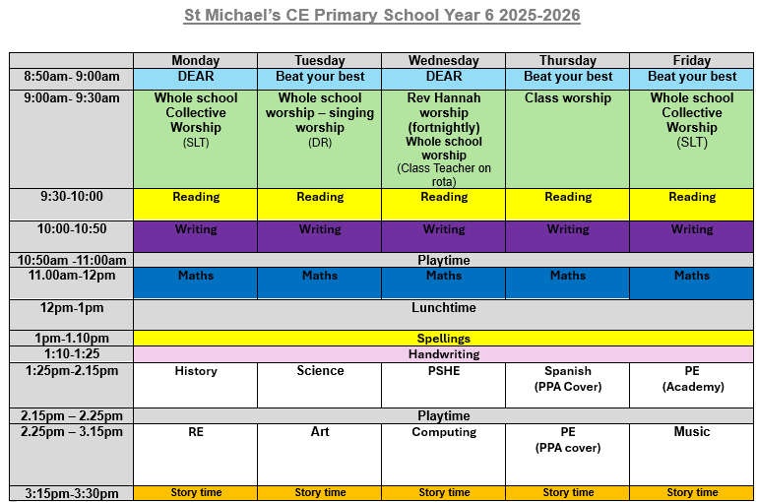

Slide 4
Overview of the year
Maths – these are the key areas.
Times tables – most important; if they know this everything is simpler.
Fractions/Decimals/Percentages
Ratio
Algebra
Converting measures
Reasoning, problem solving
Test style questions
BODMAS

Slide 5
Overview of the year
Writing
We do lots of big pieces in Y6, at least once a week.
Recap all grammar
Writing at length
Writing to suit the audience
Spellings
Handwriting

Slide 6
Overview of the year
Reading
Opinions
Predictions
Skim and scan
Use voices
Understanding that the meaning can change
Point, evidence, explain

Slide 7
Overview of the year
PE
Twice a week – Thursday and Friday.
Full kit (school kit or plain navy/white) hair tied back, no earrings/jewellery

Slide 8
Overview of the year
Homework
Times Tables weekly
Reading daily (5x a week)
English/Maths weekly

Slide 9
SATS
Monday 11th May 2026 – Thursday 14th May 2026
Reading paper
Grammar paper
Spelling
3 Maths papers (Arithmetic and 2 Reasoning)
There will be a SATs meeting after school coming up soon.

Slide 10
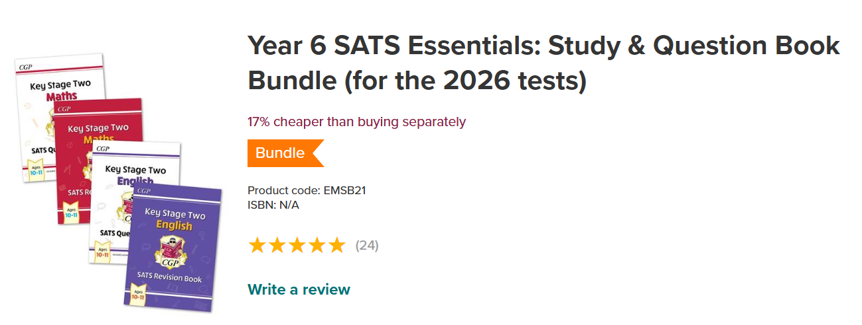
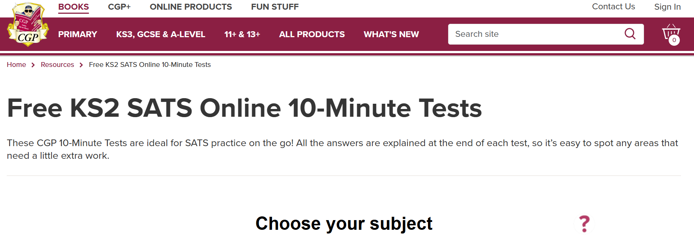
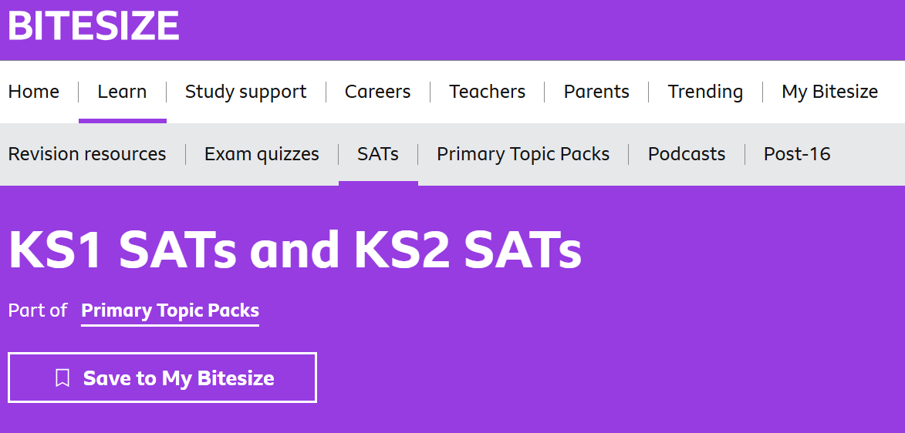
SATS

Slide 11
High School
Deadline is the 31st October!
Apply online
https://www.wigan.gov.uk/Resident/Education/Schools/School-Admissions/Secondary-Schools.aspx
Look round as many schools as possible.

Slide 12


