Slide 1

Sports Day 2020
Activity 1 – speed bounce (1 sock or chalk/
Masking tape)
1. Place a sock down.
2. Stand at the side of the sock
3. How many two footed jumps over the sock can you do in 20 seconds?
Scoring = Number of jumps = number of points

Slide 2
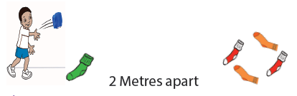
Sports Day 2020
Activity 2 – sock throw (6 socks – 4
Adult socks for the target)
1. Stand 2 metres away from the target (4 adult socks)
2. Throw 1 rolled up sock into the target
3. Run and collect your sock and repeat again
4. How many times can you land the sock into the
target in 20 seconds?
Scoring = 1 point for getting it in or hitting the target

Slide 3
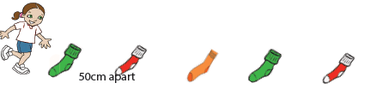
Sports Day 2020
Activity 3 – Sock ladder sprint (5
Socks or chalk/masking tape)
1. Socks to be placed 50cm apart.
2. Start behind the rst sock
3. Sprint up and down the ladder in between the socks for 20 seconds
Scoring = 1 point = 1 length of the ladder. (there and back is 2 points)

Slide 4
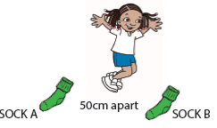
Sports Day 2020
Activity 4 – Long jump (2 socks)
1. Socks 50cm apart
2. Two footed long jump from sock A to sock B and then repeat
Scoring = 1 point for every jump

