Slide 1

Sports Day 2020
Activity 1 – Sock and Spoon (1 ROLLED UP
SOCK, TABLESPOON, 2 SOCKS FOR MARKERS)
1. Place markers e.g. socks 2 metres apart.
2. Start behind the marker
3. Children to balance the sock (rolled up) on the spoon.
4. How many shuttles can you complete in 20 seconds.
Scoring = Number of shuttles = number of points (e.g. there and back is 2 points)

Slide 2
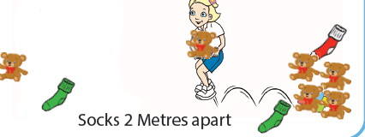
Sports Day 2020
Activity 2 – Kangaroo jump (different
Objects, 2 socks)
1. Socks 2 metres apart. Line up behind the marker
2. Kangaroo jump (2 footed jump) to collect your teddy or soft toy
3. Jump and take it back to the starter marker
4. How many objects can you collect in 20
seconds?
Scoring = Number of objects = number of points

Slide 3
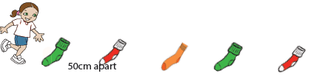
Sports Day 2020
Activity 3 – Sock ladder sprint (5
Socks or chalk/masking tape)
1. Socks to be placed 50cm apart.
2. Start behind the rst sock
3. Sprint up and down the ladder in between the socks for 20 seconds
Scoring = 1 point = 1 length of the ladder. (there and back is 2 points)

Slide 4
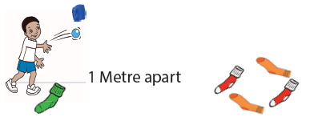
Sports Day 2020
Activity 4 – Sock it (5 socks or
Chalk/masking tape)
1. Stand 1 metre away from the target (4 adult socks)
2. Throw 1 rolled up sock into the target or on the target
3. Run and collect your sock and repeat again
4. How many times can you land the sock into or on the
target in 20 seconds?
Scoring = 1 point for getting it in the target

