Slide 1

Welcome to Year 5!

Slide 2
The year 5 team -
Class Teacher – Miss Bennett
HLTA and PPA Cover – Mrs Roberts
Mrs Roberts PPA –
Thursday Morning
Friday Afternoon

Slide 3
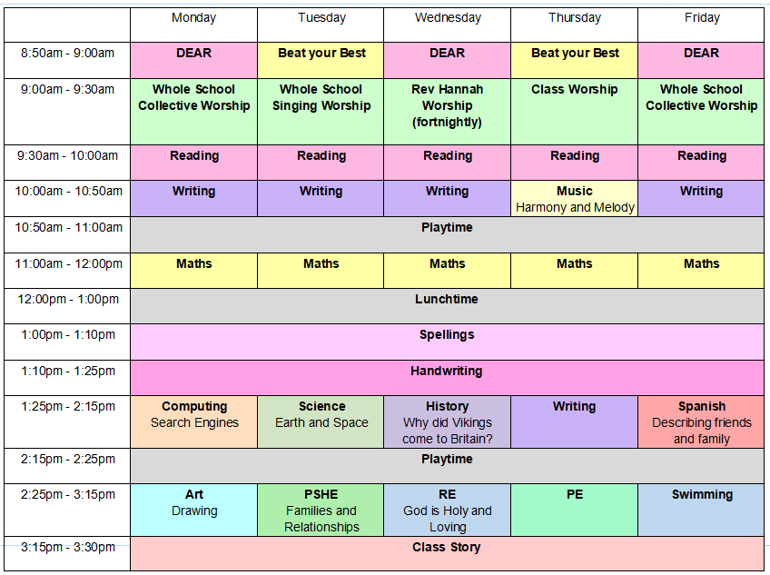
Weekly Timetable
Daily –
Reading, Writing, Maths, Spelling, Handwriting
Weekly –
Science, RE, PSHE, Computing, Spanish, Music, 2x PE
Alternating –
Geography/ History, Art/ DT

Slide 4

Overview Of the Year - Maths
Autumn Term
Place Value
Addition and Subtraction
Multiplication and Division
Fractions
Spring Term
Multiplication and Division
Fractions
Decimals and Percentages
Perimeter and Area
Statistics
Summer Term
Shape
Position and Direction
Decimals
Negative Numbers
Converting Units
Measurement - Volume

Slide 5






Overview of the Year - English
Spring 1 – Myth
Spring 2 – Biography
Summer 1 – Information
Summer 2 – Soliloquy
Autumn 1 – Diary
Autumn 2 – Traditional Tale

Slide 6




Autumn one overview - foundation
Science – Earth and Space
RE –
PSHE – Families and Relationships
Art – Drawing: Depth, Emotion and Movement
History – Why did the Vikings come to Britain?
Computing – Computing systems and Networks
Music – Melody and Harmony
Spanish – Describing family and friends
What does it mean for Christians to believe that God is holy and loving?

Slide 7
PE
Thursday – Indoor PE
Friday – Swimming
Children must come in full PE kit
On Friday, children must bring:
Swimming costume/ trunks
Towel
Goggles
A separate swimming bag

Slide 8

Homework
Handed out – Friday
Return on – Wednesday
Reading Daily
English or Maths Weekly (In Homework Folders)

Slide 9

How can you help at home?
Reading at home and recording reads
Using VIPERS questions to check comprehension
Offering homework help
Support with times tables
Message me on dojo with any questions or concerns

Slide 10

Any questions?

