Slide 1

Year 2
Ms Clisham
Miss McMillan
Miss Morley
Mrs Roberts

Slide 2
What do we want from your child?
To challenge themselves and always work to the best of their ability
To become more independent
To have fun!
To have a growth mindset.

Slide 3
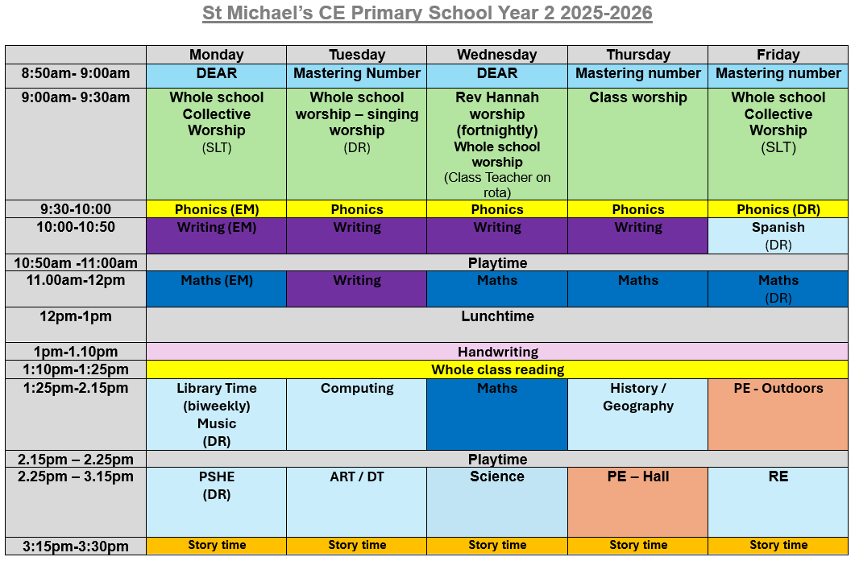

Slide 4
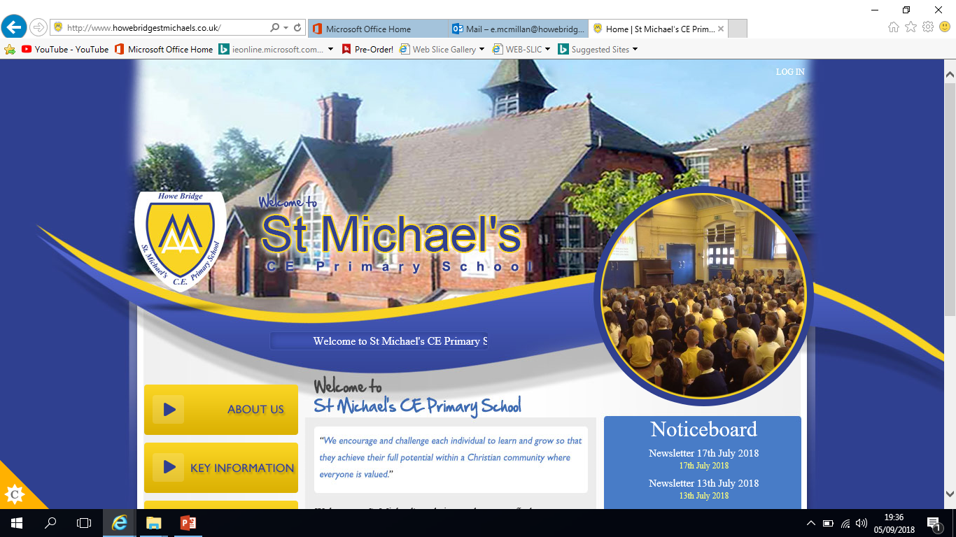
Communication via;
Class dojo

Slide 5

Reading/ Home learning
Please note we have changed home learning policy.
Reading 5 times a week.
Home learning - Reading,1 English or Maths activity (rotated)
Homework will be handed out on a Friday and returned by Wednesday.
Spellings will go out on Friday, along with the homework, and
will be tested on Thursdays.
Any problems or concerns over home learning let us know.

Slide 6

Reading at home

Slide 7
Becoming readers and writers
Before children can learn to read and write they need to develop their understanding of the English language. For all of us this happens through talk.
Through talk we learn new vocabulary and the knowledge of how to structure sentences.
In school we encourage the children to talk in a variety of situations.

Slide 8
Assessments
End of Key Stage 1 tests – exactly the same as the test base tests done at the end of each term in Year 1.
Phonics screening check

Slide 9


Slide 10
Trips
Pantomime –Autumn 2
Visitors – RockKids (10th September)
Trips to the local park each term to observe the seasonal change.
More trips - tbc

Slide 11
FSM
You can speak to the Business manager Mrs Fallon if you think you may be eligible for free school meals. It is a quick, easy process but can make a massive difference.

Slide 12
Useful Websites
http://www.oxfordowl.co.uk/
https://www.topmarks.co.uk/maths-games/5-7-years/
http://www.bbc.co.uk/bitesize/ks1/literacy/
http://www.bbc.co.uk/schools/magickey/adventures/hms.shtml
http://www.ictgames.com/lcwc.html
http://www.bbc.co.uk/schools/magickey/adventures/floppy_game.shtml
http://www.bbc.co.uk/cbeebies/stories/

Slide 13

Open door policy!
Please let us know of any concerns or worries you have and we will work together to problem solve and support your child.

