Slide 1
Year 1 writing workshop

Slide 2

At St.Michael’s we give children lots of exposure to rich language environment
• Stories
• Fun and creative ideas
• Everyday experiences
• Drama
We underpin these experiences with sound teaching of phonics, spelling, handwriting, grammar and punctuation.

Slide 3
Becoming readers and writers
Before children can learn to read and write they need to develop their understanding of the English language. For all of us this happens through talk.
Through talk we learn new vocabulary and the knowledge of how to structure sentences.
In school we encourage the children to talk in a variety of situations.

Slide 4
Phonics
• There are 44 sounds that are used in the English language. However many have the same sound but a different appearance.
• In English there are more than 150 graphemes which means it is a very complex code.
We focus on pure sounds not letter names.
For example:
e is sounded as ‘eh’ not ‘eee’
f is sounded as ‘ffff’ not ‘eff’
Here is a video to support saying the sounds;
http://www.oxfordowl.co.uk/for-home/reading-site/expert-help/phonics-made-easy

Slide 5
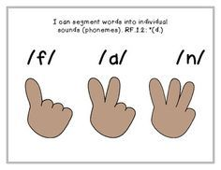
Eyes are for reading, fingers are for spelling
• Children convert a whole word they hear into sounds
• They put sounds they hear in a word on their fingers.
• We call these Phoneme Fingers

Slide 6
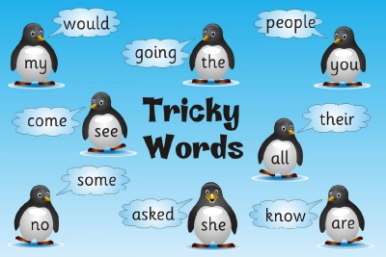
Common Exception Words - How you can help your child learn their spellings.
• Try to make practising fun by playing games that encourage careful listening to the sounds in words and looking for letter patterns.
• Your child may enjoy singing or reciting spellings.
Time challenges.

Slide 7
Talk for Writing ‘If you can’t say it, you can’t write it’
THINK IT
SAY IT
WRITE IT (using phonic and word knowledge)
READ IT (check for capital letters, full stops, finger spaces, check for Grammar!)
LIKE IT

Slide 8
Brainstorm Word Alternatives
Said - argued, squawked, rambled, called, yelled etc …
How many words can you think of for brainstorm alternatives for nice?

Slide 9
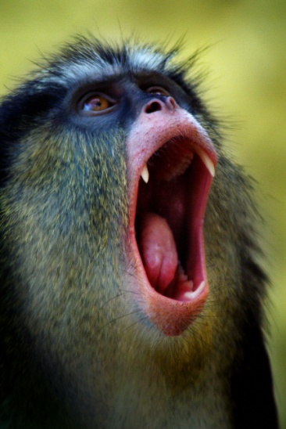
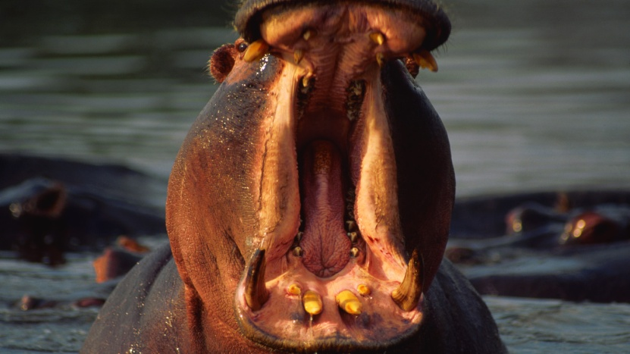
The cat went along the wall.
Ban Boring Sentences
We help the children develop their sentences by using VCOP.

Slide 10
The cat went along the wall.
We use vocabulary to add adjectives to describe and changes dull words for interesting alternatives! We often use the thesaurus to support this!
The fluffy ginger cat prowled
along the red brick wall.

Slide 11
The fluffy ginger cat prowled
along the red brick wall.
We use connectives to add more detail or action to the sentence.
The fluffy ginger cat prowled along the red brick wall because he was spying on a juicy bird.

Slide 12
The fluffy ginger cat prowled along the red brick wall because he was spying on a juicy bird.
We use different openers to change the beginning of the sentence to grab your reader’s attention!
Whilst licking his lips, the fluffy ginger cat prowled along the red brick wall because he was spying on a juicy bird.

Slide 13
Whilst licking his lips, the fluffy ginger cat prowled along the red brick wall because he was spying on a juicy bird.
We make an impact by using different punctuation.
Whilst licking his lips, the fluffy ginger cat prowled along the red brick wall because he was spying on a juicy bird!

Slide 14
The cat went along the wall.
We went from:
To:
Whilst licking his lips, the fluffy ginger cat prowled along the red brick wall because he was spying on a juicy bird!
Using VCOP!
What a wonderful way to improve our writing!

Slide 15
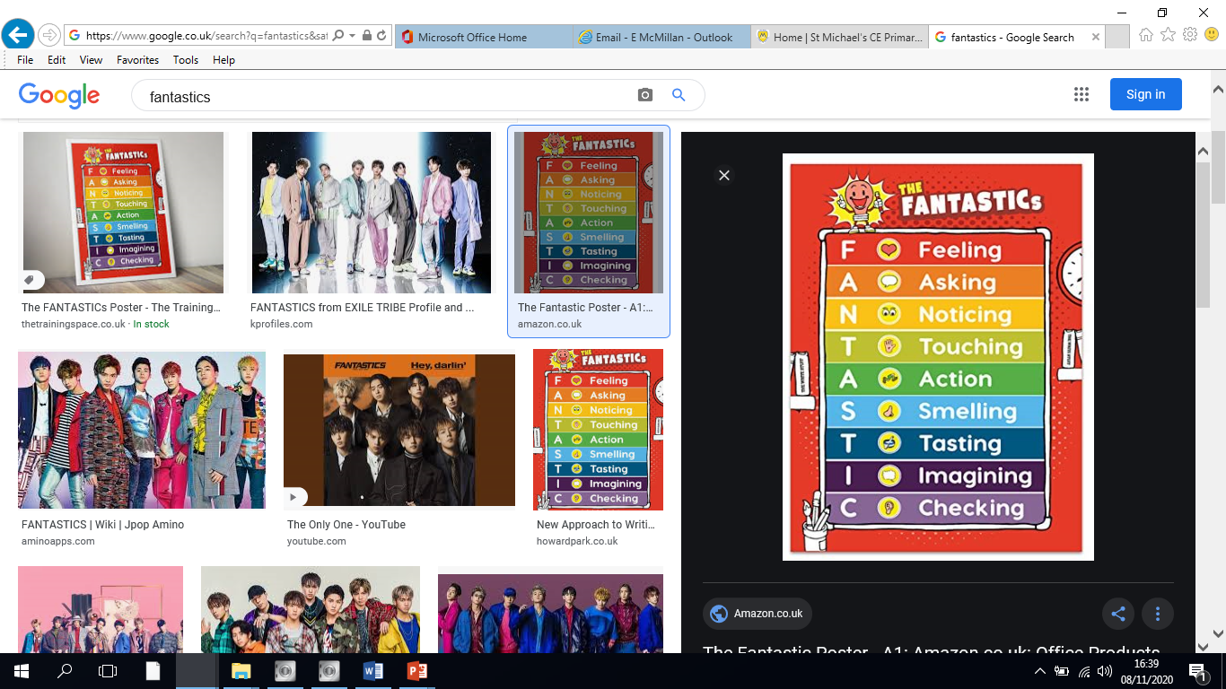
We use the FANTASTICs to make our writing really interesting. We use these lenses to vary our sentences.

Slide 16
What can you do to help?
Encourage and praise all mark making
Ask questions like: Which sound does it begin with?
Support your children in writing in lower case not CAPITAL LETTERS as this will help them identify the sounds.
Model your writing with your child so that they can see its purpose; shopping lists, to do lists etc.
When talking with your child introduce new vocabulary and use it within context.
Read stories to your child and explain new words which you come across

Slide 17
Try to provide your child with ;
•Pencils
•Pens
•Paper
•‘Post it’ notes
•Note pads
•A good place to write – a desk or table with a smooth, flat surface and good lighting.

Slide 18
You can provide opportunities to support the Development of Writing
• Menus
• Lists
• Cards
• Letters
• Story maps
• Stories
• Newspaper reports
• Poems
• Making books
• Word games and puzzles
• Comics

Slide 19

BE CAREFUL!
• Try not to point out every mistake
• Celebrate writing and small steps
• Try to pick out the best bits

Slide 20
Useful Websites
http://www.oxfordowl.co.uk/
http://www.bbc.co.uk/bitesize/ks1/literacy/
http://www.bbc.co.uk/schools/magickey/adventures/hms.shtml
http://www.bbc.co.uk/schools/magickey/adventures/lug.shtml
http://www.ictgames.com/lcwc.html
http://www.bbc.co.uk/schools/magickey/adventures/floppy_game.shtml
http://www.bbc.co.uk/cbeebies/stories/

