Slide 1

Year 1
Miss Lees
Miss McMillan
Miss Smith

Slide 2
What do we want from your child?
To challenge themselves and always work to the best of their ability
To become more independent
To have fun!
To have a Growth mindset.

Slide 3
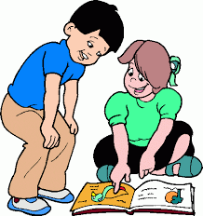
Timetable. (on website)
*Handwriting, English, Maths, phonics each day.
*PE.
Monday and Wednesday.
Children to come to school in PE uniform. Please ensure earrings have been/can be removed & hair is tied up.
*Playtime snacks – healthy. Morning snack – bring own.
Afternoon break they get fruit but its limited choice so you may want to bring your own.
Water bottle everyday.

Slide 4
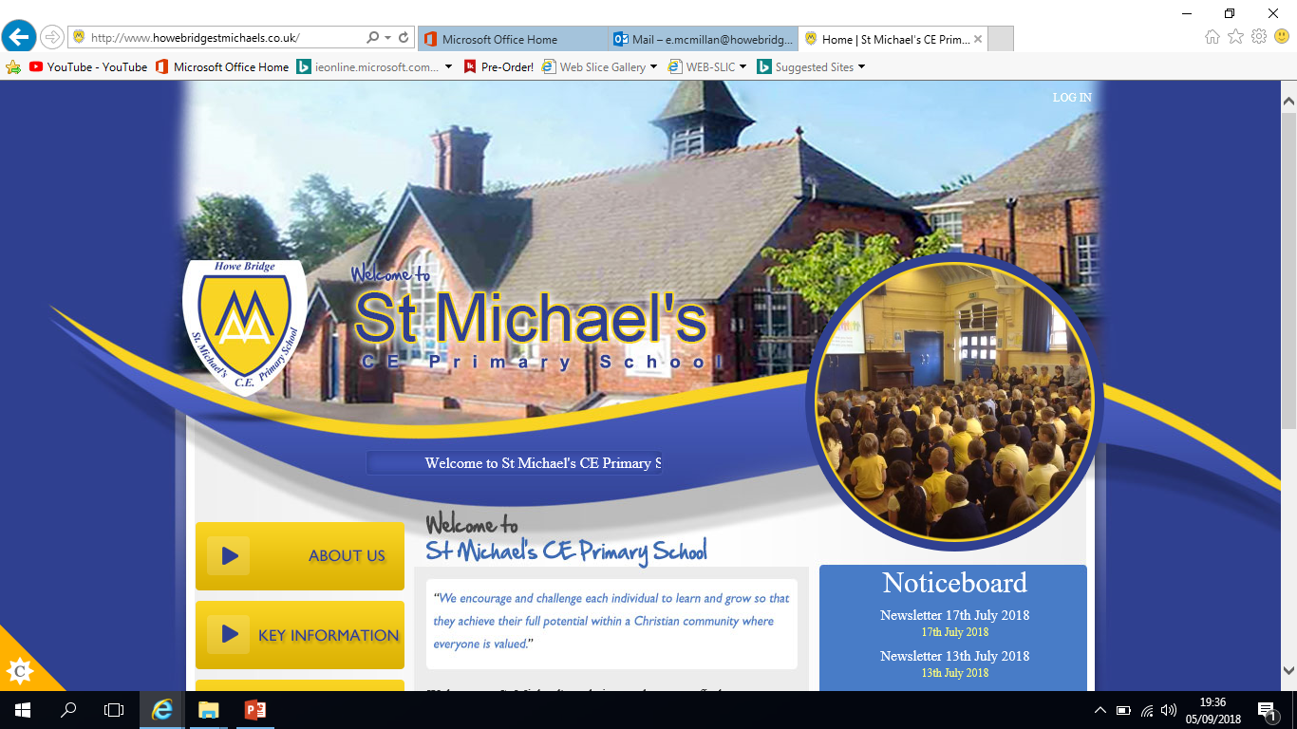
Communication via;
Class dojo

Slide 5
Reading/ Home learning
Please note we have changed home learning policy.
Reading 5 times a week. (Change books after read completely twice and can answer questions about the book)
Home learning – Reading and spelling. (spelling in Autumn 1 is reading common exception words)
1 English or Maths activity (rotated)
Any problems or concerns over home learning let us know.

Slide 6

Reading at home.

Slide 7
Becoming readers and writers
Before children can learn to read and write they need to develop their understanding of the English language. For all of us this happens through talk.
Through talk we learn new vocabulary and the knowledge of how to structure sentences.
In school we encourage the children to talk in a variety of situations.

Slide 8
Phonics.
Children will sit a phonics screening test in June 2026. This is nothing to worry about, the children will not realise they are sitting a test. They will read some real words and alien words.
• There are 44 sounds that are used in the English language. However many have the same sound but a different appearance.
• In English there are more than 150 graphemes which means it is a very complex code.
We focus on pure sounds not letter names.
For example:
e is sounded as ‘eh’ not ‘eee’
f is sounded as ‘ffff’ not ‘eff’
https://www.youtube.com/watch?v=BqhXUW_v-1s

Slide 9
Trips
Pantomime –Autumn 2
Blackpool Zoo – Spring 2
Bring Yer Wellies – Summer 2
Trips to the local park each term to observe the seasonal change.
Visitors – RockKids (10th September),paramedic, Jewish faith leader

Slide 10
FSM
You can speak to the Business manager Mrs Fallon if you think you may be eligible for free school meals. It is a quick, easy process but can make a massive difference.

Slide 11
Useful Websites
http://www.oxfordowl.co.uk/
https://www.topmarks.co.uk/maths-games/5-7-years/
http://www.bbc.co.uk/bitesize/ks1/literacy/
http://www.bbc.co.uk/schools/magickey/adventures/hms.shtml
http://www.ictgames.com/lcwc.html
http://www.bbc.co.uk/schools/magickey/adventures/floppy_game.shtml
http://www.bbc.co.uk/cbeebies/stories/

Slide 12

Open door policy!
Please let us know of any concerns or worries you have and we will work together to problem solve and support your child.

